Slide 1
Which country SHOULD YOU move to?
Capstone Project - The Battle of the Neighborhoods (Week 2)
Applied Data Science Capstone by IBM/Coursera

Slide 2
What is important?
Assume you move to other countries, what is the most important factor for you to be comfortable there?

Slide 3

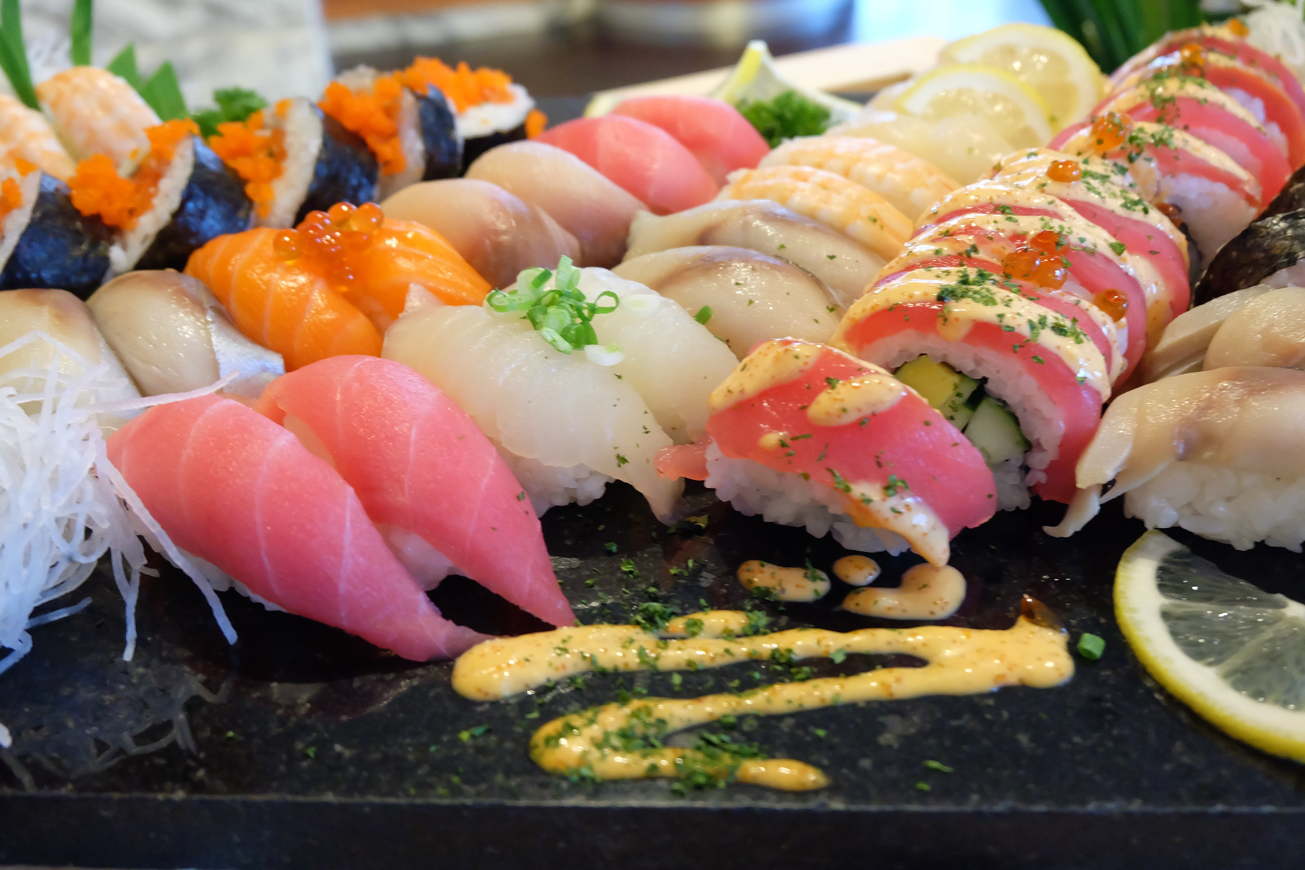
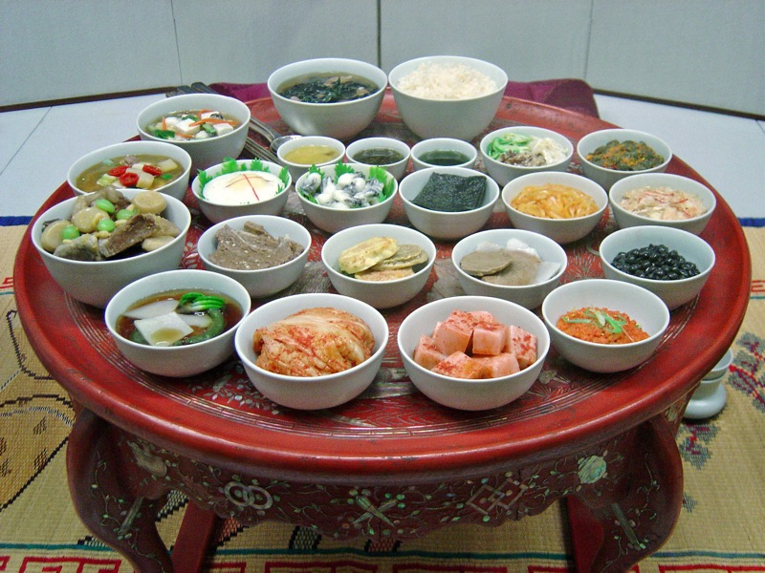

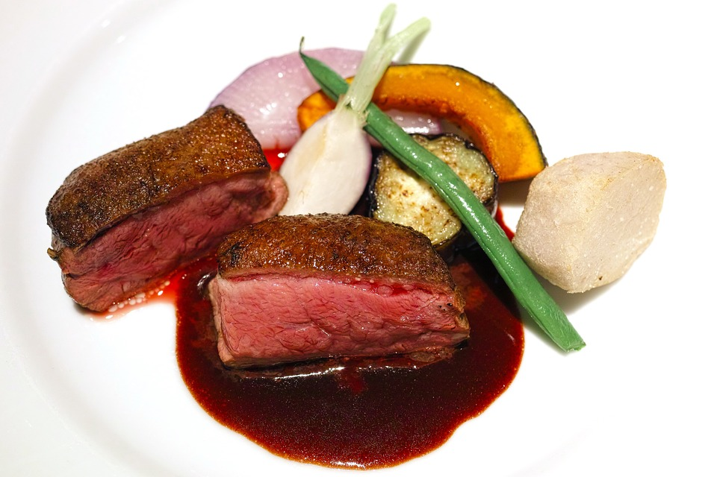
The answer is food
Does the country have the same kinds of restaurants as your country?

Slide 4
ASK foursquare API
Get Venue Recommendations
GET https://api.foursquare.com/v2/venues/explore
Parameters
Name | Description
Section | One of food, drinks, coffee, shops, arts, outdoors, sights, trending, nextVenues (venues frequently visited after a given venue), or topPicks (a mix of recommendations generated without a query from the user). Choosing one of these limits results to venues with the specified category or property.

Slide 5
Also ask K-MEANS
K-Means is a clustering algorithm
Let’s cluster countries based of the category of restaurants available in each country

Slide 6
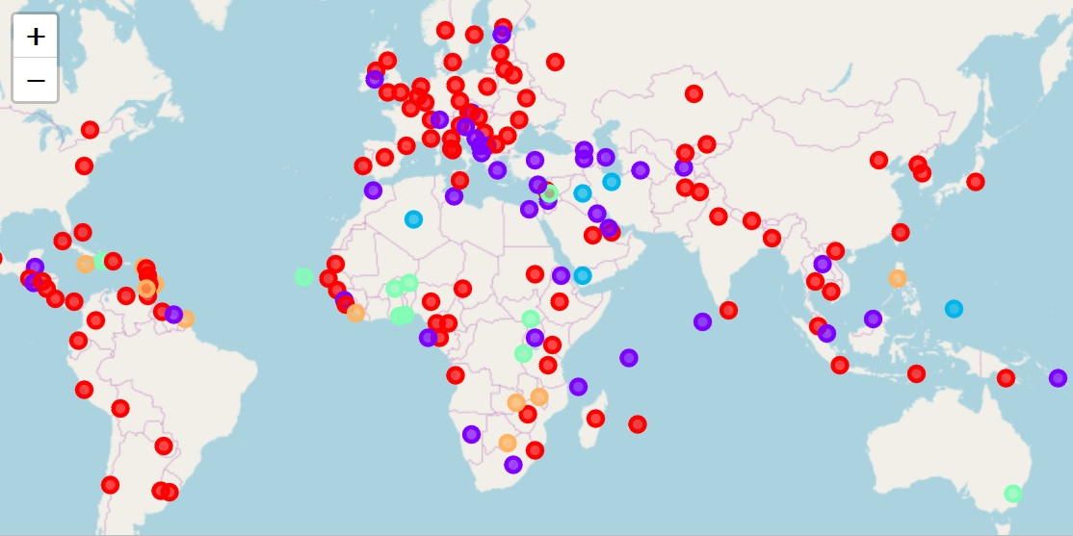
IF YOU ARE FROM RED, move to red

